Slide 1
Design, Develop, Implement & Document Community Portal Website
Module Project
Module: Web Development Foundations
Course: NICF Advanced Certificate in Software & Applications (Development & Deployment)
Start Date : 25 August 2022
End Date : 21 September 2022
Submission Date :
Learner Name : Viddy Virstandi P.A.P
Enrollment ID : BDSE-0322/STTB
Presentation Date :

Slide 2
Contents
Document History
Version Number | Effective Date of release | Summary of Included Changes | Author
1 | 4th March 2016 | First Edition | Satya CVS
2 | 08th Sep 2017 | Changed for Module 5 | Shrinivas K R
3 | 20th Jul 2018 | Changed for Module 5 RQF | Shrinivas K R

Slide 3
Contents
Contents
S. No. | Description
01 | Development Tools
02 | Business Process
03 | Application Block Diagram
04 | Applications
05 | Models, Controllers & Classes Developed
06 | UI Design
07 | Includes
08 | Software Development Methodology
09 | Project Plan
10 | Application Screen Shots
11 | Project Milestones & Tasks
12 | Milestone Feedback & Action Taken
13 | Modifications Made On Feedback
14 | Project Results
15 | Proposed Improvements

Slide 4
1. Development Tools
Development Tools
a. Spring Framework
  b. MySQL Workbench 8.0
  c. Eclipse
  d. Microsoft Word
  e. Microsoft Powerpoint

Slide 5
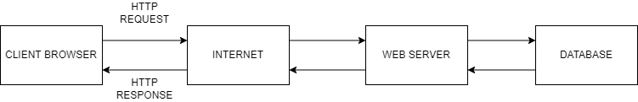
2. Business Process
Block Diagram of Various Business Process

Slide 6
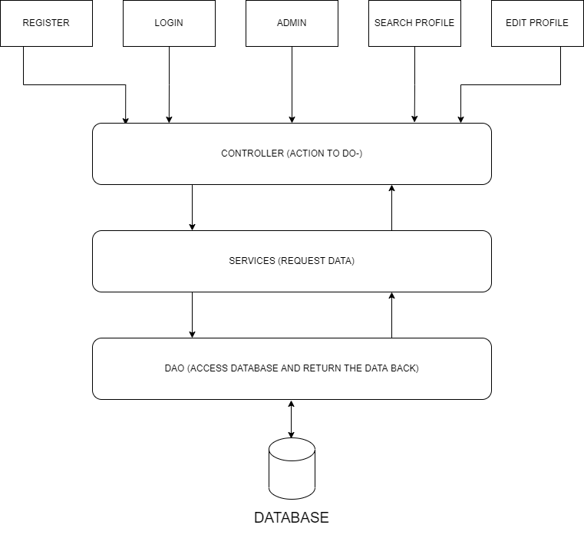
3. Application Block Diagram
Block Diagram of the Over all Application

Slide 7
4. Applications
Description of Applications being Developed in Eclips
We have been approached by ABC Jobs Pte Ltd to develop a community portal for software developer. ABC Jobs Pte Ltd is a website development company, this company has a new project to develop a website for Community Portal similar to Linked.in, in this project ABC Jobs requires a scenario for users to register on the registration page, users can search for other users with various parameters such as First Name, Last Name, Company Name, City and Country. Users will be able to view the Public Profile of users after searching them. The portal allow users to login, request for forgotten password and Update their profile information.
In the project in this module to develop a ABC Jobs using Jsp, CSS, JavaScript, and Spring

Slide 8

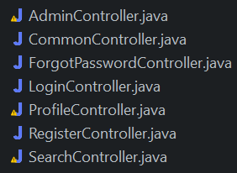



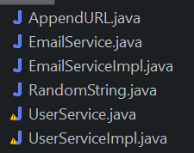
5. Models, Controllers, Classes Developed
Overview of Models, Controllers & Any Classes Developed
Config
Controller
DAO
model
repo
Services

Slide 9
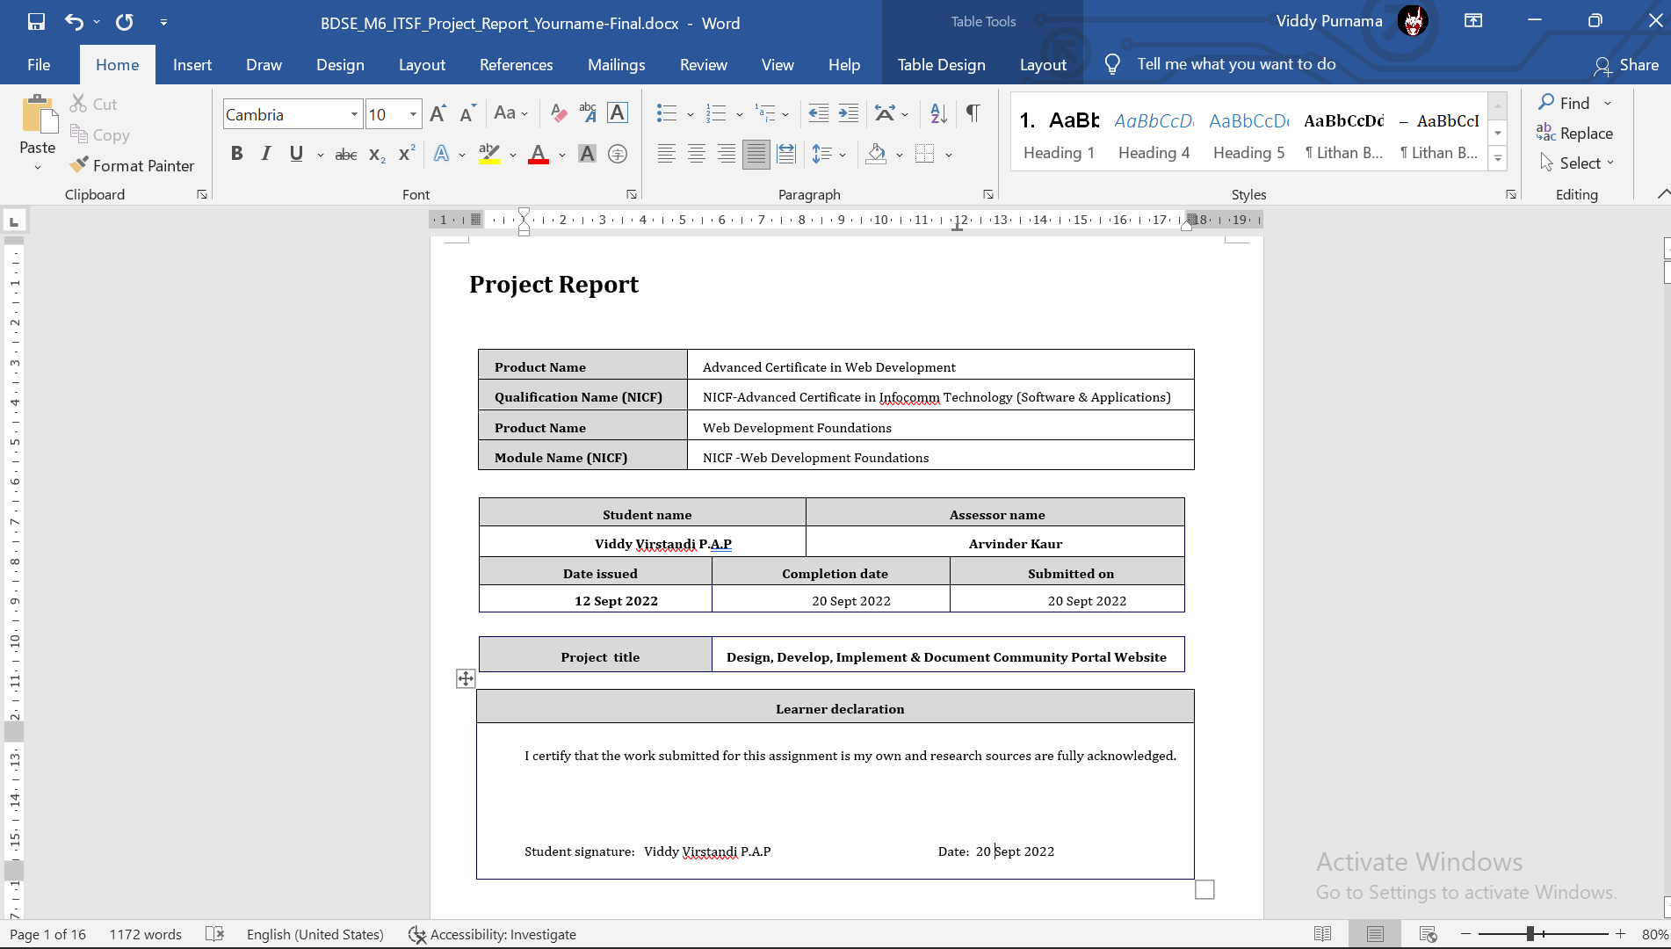
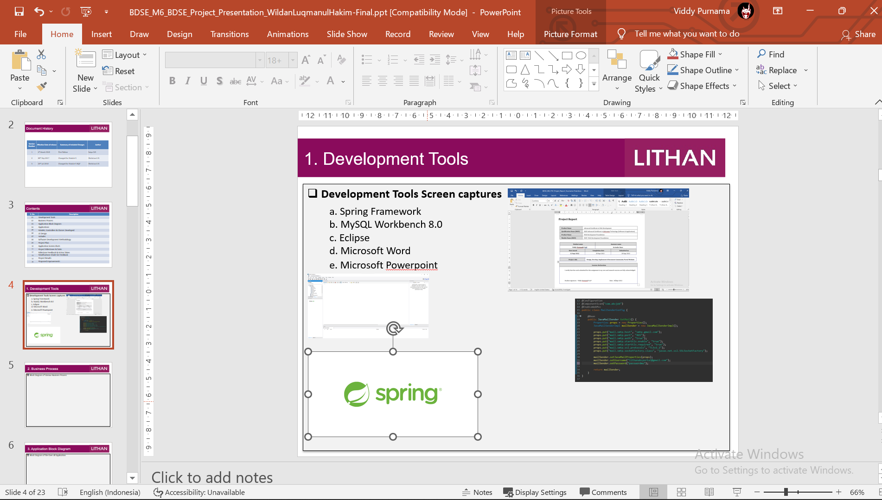
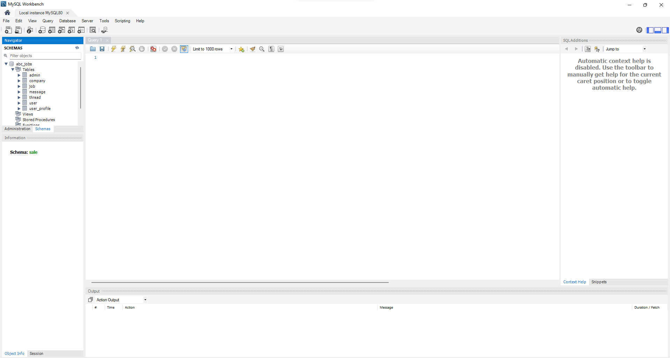

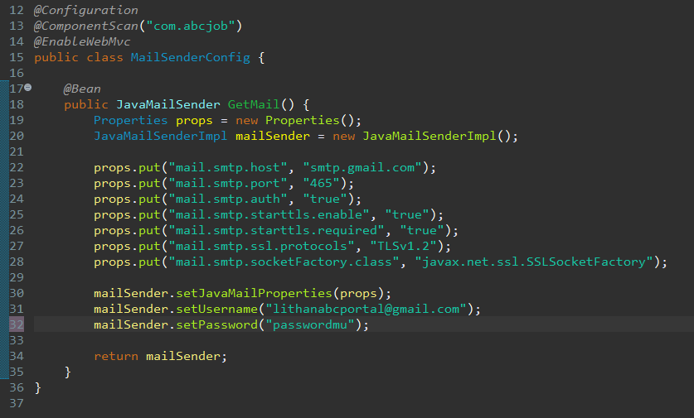
6. Tool Screens
Tool Screens

Slide 10
7. Classes - Entities
Entities
S. No. | Class Name | Description
1 | userId | Id of the user
2 | firstName | First name of the user
3 | lastName | Last name of the user
4 | Email | Email of the user
5 | Pass | User password
6 | Country | User country
7 | City | User city
8 | Phone | User phone number
9 | Company | The companyof the user
10 | role | User role (admin/SE)
11 | Reset_password_token | Token for user to reset password

Slide 11
8. Classes Developed
Business Classes
S. No. | Class Name | Description
1 | JPAConfig | Connect to database
2 | WebMvcConfig | Set prefix and suffix of view
3 | AdminController | To control the flow of the model and view of admin
4 | UserDao | Fetch and store data to database
5 | User | To make model of the user and will be connect to database
6 | UserRepository | Connect to JPA Repository and make the header of method
7 | UserService | Implementation of UserRepository
8 | EmailService | Make method header of email process
9 | EmailServiceImpl | To send “registration” and “forget password” email
10 | RandomString | Generate forget password token

Slide 12
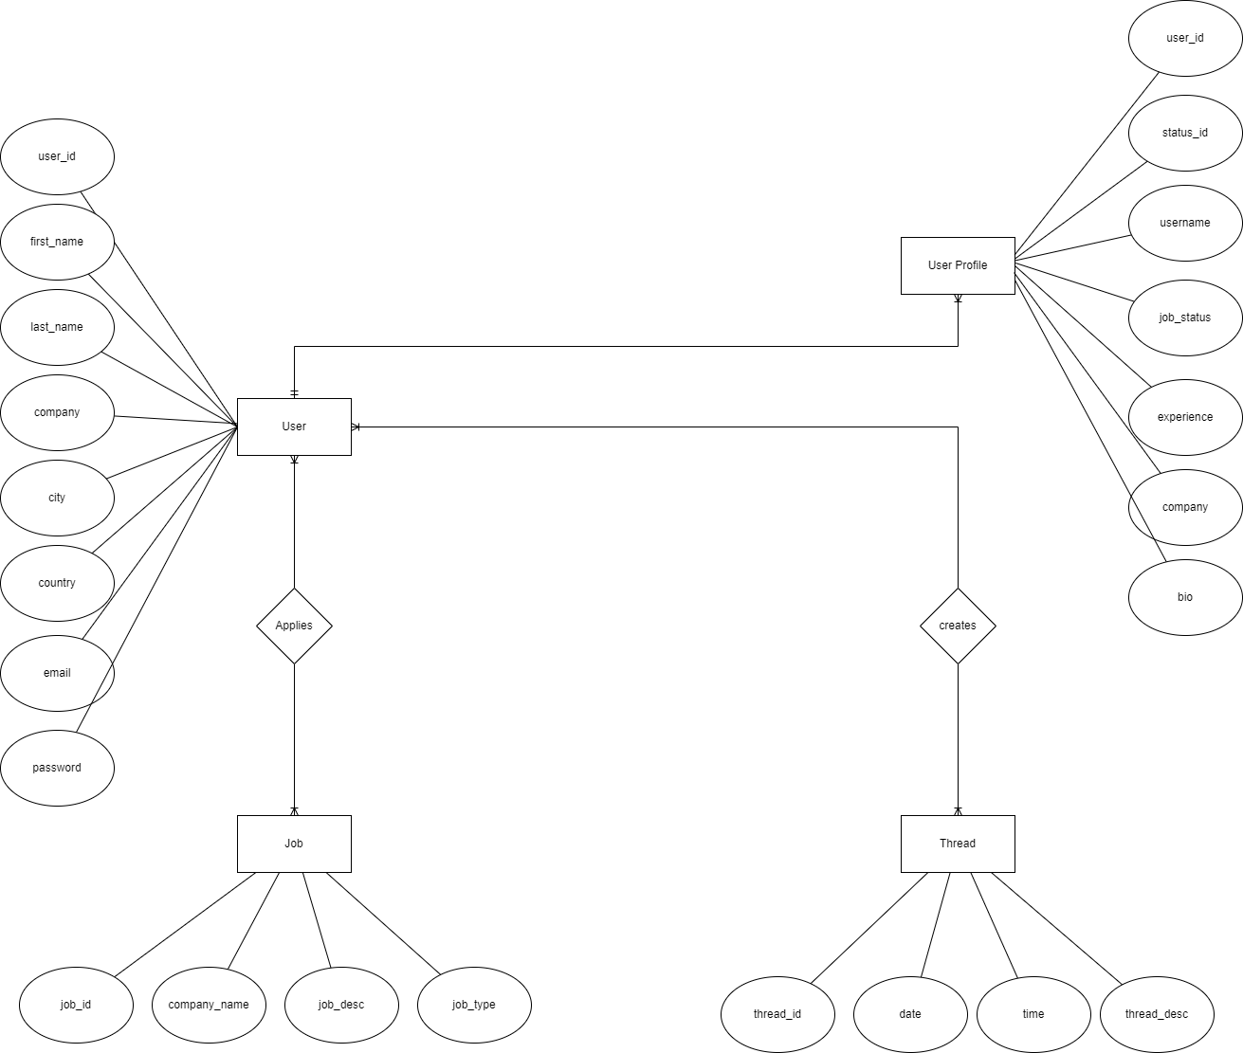
9. Database Design
Paste the ER Diagram Developed in Module 4

Slide 13
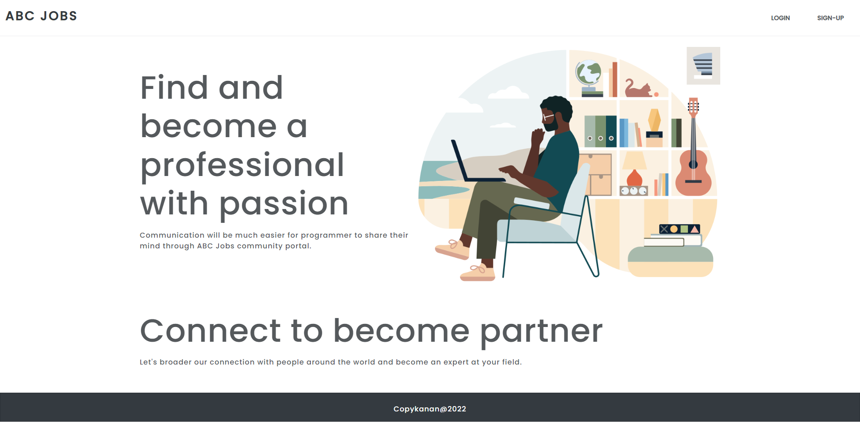
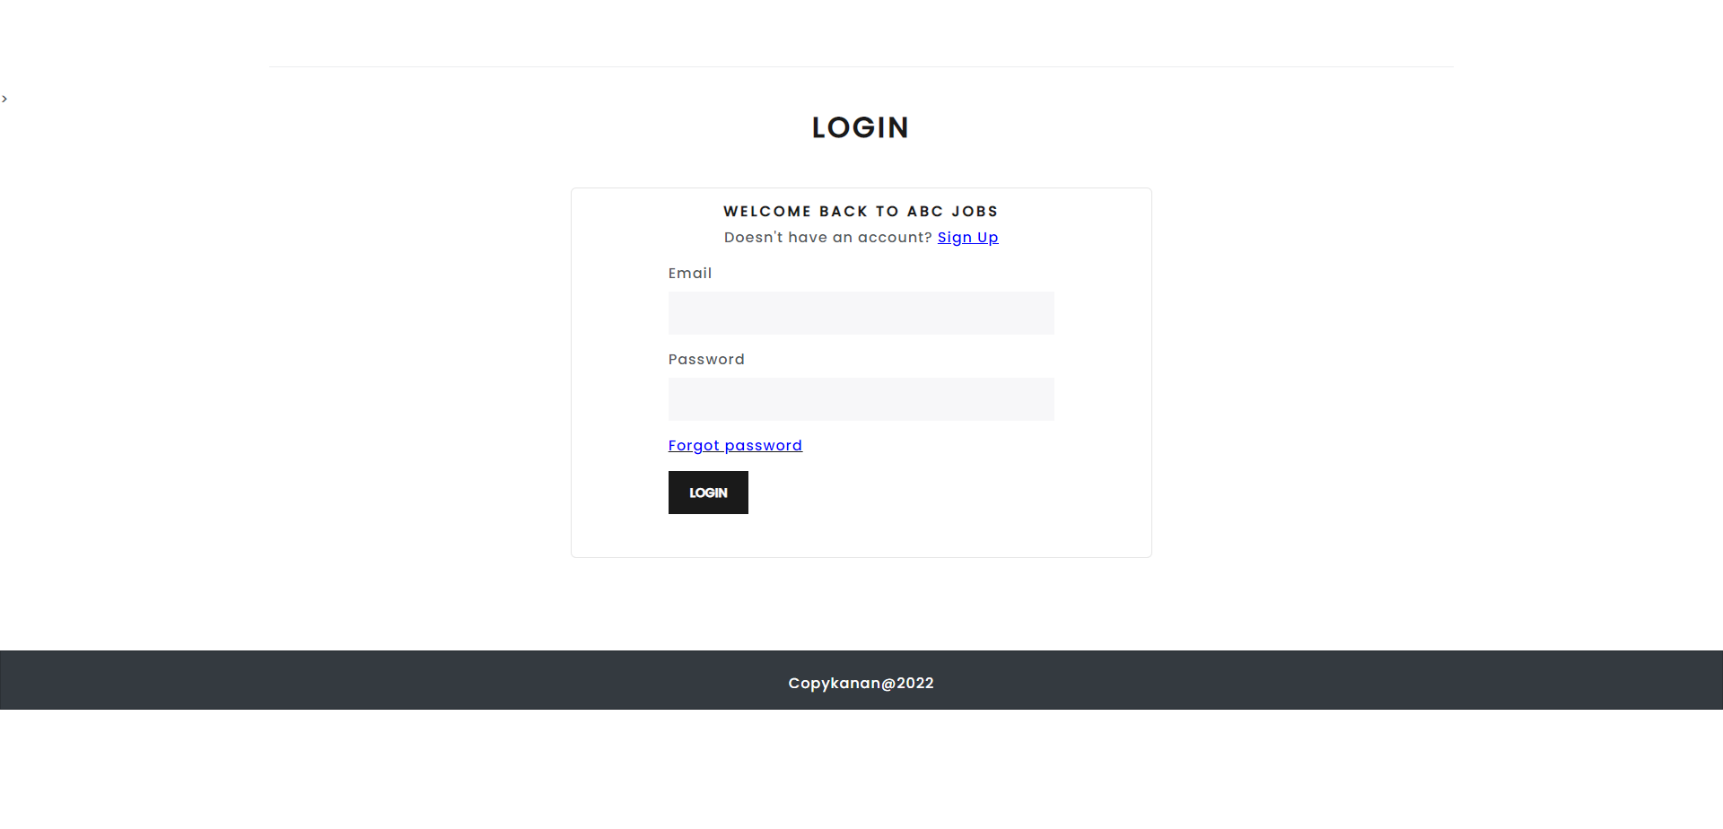
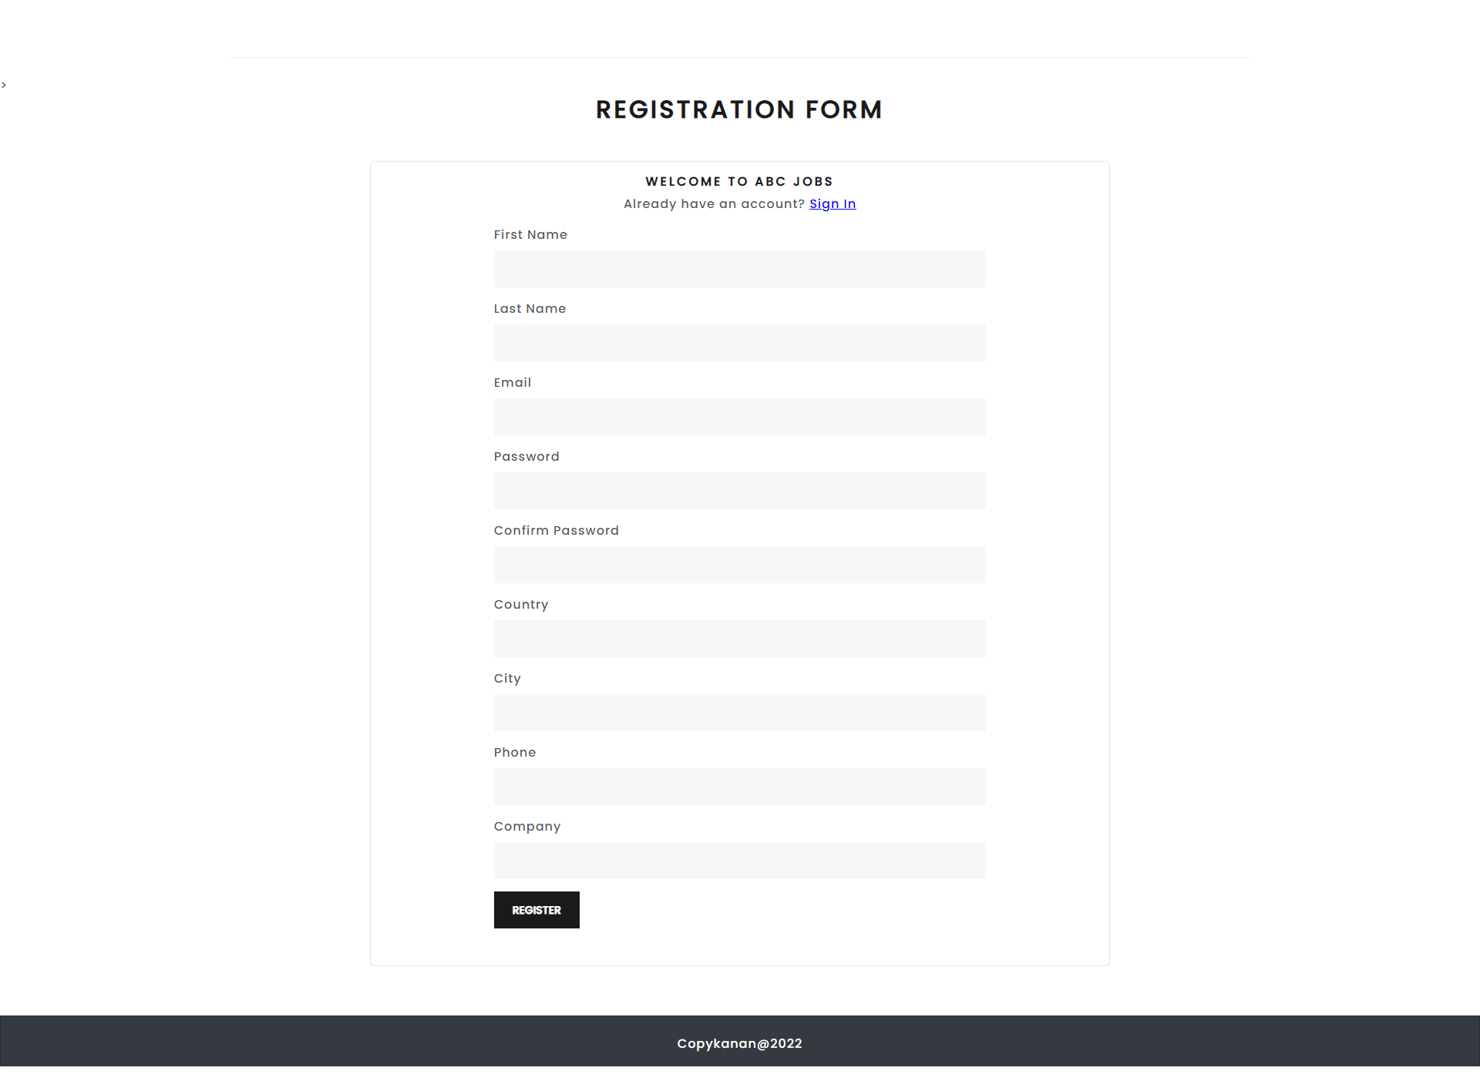
10. UI Design

Slide 14
11. Struts Includes
Apache Struts Includes
S. No. | Include | Purpose of Inclue

Slide 15
12. Software Development Methodology
Software Development Methodology being used
Waterfall Model
It’s a sequential model of SDLC. In this model, the software development activity is divided into different phases and each phase consist of a series of task and has different objectives. It is a mandatory for a phase to be completed before the next phase start.
Requirement & Gathering Analysis
System Design
Implementation
Testing
Deployment
Maintenance

Slide 16
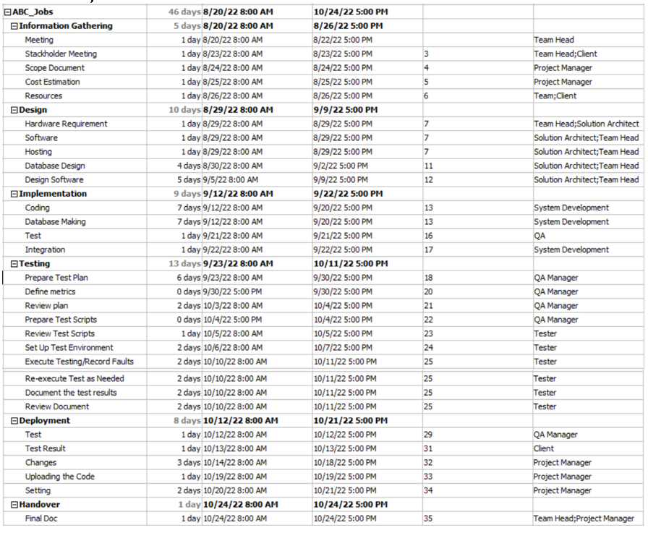
13. Project Plan
Project Plan

Slide 17
14. Application Screen Shots

Slide 18
15. Project Milestones & Tasks
Project Task ID | Project Task Description | Project Milestone ID
1 | Setup the Development Environment based on the Technical Development Environment | 1
2 | Power point Detailing the Business Process in the Proposed Application | 1
3 | Project Report detailing the Technical Design | 1
4 | Power Point Detailing the Project Plan | 1
5 | Develop the UI HTML standard pages (Based on Module 3 work) | 2
6 | Create common Struts Includes, Models, Views & Controllers | 2
7 | Develop Classes | 2
8 | Develop Struts Application | 2

Slide 19
16. Project Milestones & Tasks
Project Task ID | Project Task Description | Project Milestone ID
9 | Develop Test Cases | 3
10 | Develop Project Documentation | 3
11 | Develop User Manual | 3

Slide 20
17. Milestone Feedback & Action taken
Project Milestone ID | Milestone Feedback received from Tutor / Learning Facilitator | Action Taken (Yes / No)
1
2
3

Slide 21
18. Modifications Made based On Feedback

Slide 22
19. Project Results
List of Pages
http://localhost:8080/abcportal/
http://localhost:8080/abcportal/login
http://localhost:8080/abcportal/register
http://localhost:8080/abcportal/homepage
http://localhost:8080/abcportal/profile
http://localhost:8080/abcportal/search
http://localhost:8080/abcportal/admin/dashboard
http://localhost:8080/abcportal/admin/adduser
http://localhost:8080/abcportal/admin/edituser/

Slide 23
20. Proposed Improvements
List of Improvements
  Add change profile picture
  Add apply for job
  Add thread system
  Add message system

